Slide 1
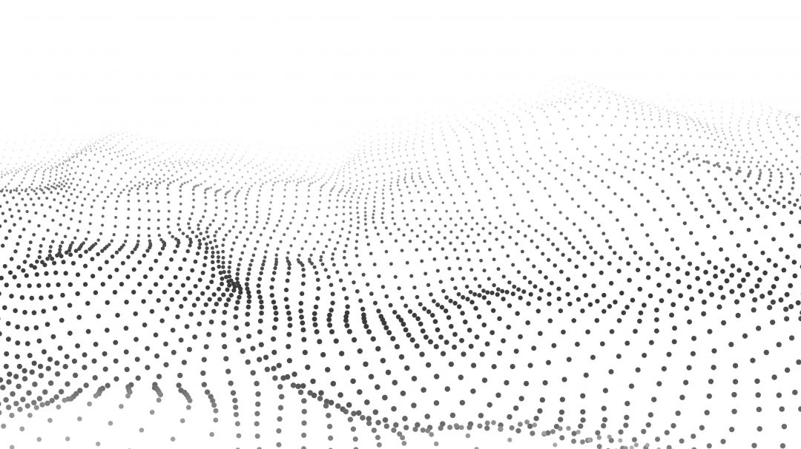

3D Sensor Data Processing (2023)
Model fitting &
Point Cloud Features
2023. 09. 10
윤형석 (hyongseok.yoon@cmesrobotics.ai)

Slide 2
References – Most of slides are from these references
Least Squares:
Least Squares - An Informal Introduction (Cyrill Stachniss)
SLAM Online Study | SLAM DUNK Season 2 | An Informal Introduction to Least Squares
발표자(Peter Woo) 고화질 영상
Hough Transform:
[First Principle of Computer Vision] Hough Transform | Boundary Detection
The University of British Columbia, CPSC 425: Computer Vision Lecture 15: Hough Transform
RANSAC:
3D Computer Vision | Lecture 4 (Part 2): Robust homography estimation
SLAM Online Study | SLAM DUNK Season 2 | RANSAC
The University of British Columbia, CPSC 425: Computer Vision Lecture 14: Planar Geometry and RANSAC
Harris Corner Detector:
[시각지능] Detecting corners (POSTECH의 오태현 교수님의 시각지능 강의)
The University of British Columbia, CPSC 425: Computer Vision Lecture 9: Corner Detection
ISS(Intrinsic Shape Signatures)
Intrinsic Shape Signatures: A Shape Descriptor for 3D Object Recognition (Original Paper)

Slide 3
References – Most of slides are from these references
Point Descriptors:
Overall:
PCL/OpenNI tutorial 4: 3D object recognition (descriptors)
PFH:
원 논문: Persistent Point Feature Histograms for 3D Point Clouds
한국인 블로그: PFH
PFH & FPFH:
[AIRLAB@KHU 논문세미나] Fast Point Feature Histograms(FPFH) for 3D Registration
FPFH:
원 논문: Unique Signatures of Histograms for Local Surface Description

Slide 4
Contents & Objectives
Model Fitting
Least Squares Fitting
Hough Transform
RANSAC (Random Sample Consensus)
Point Cloud Features
Feature Detectors
Harris 3D/6D
Intrinsic Shape Signatures
Feature Descriptors
Point Feature Histogram
Fast Point Feature Histogram
Signature of Histograms of Orientations
What is Least Squares Limitations and why?
Hough Transform & RANSAC pros and cons
What is 2D Harris Corner Detector and 3D Harris Corner Detector?
Differences between PFH, FPFH, LRF, SHOT
(Basics)
Taylor Expansions
Eigen Values and decompositions
[Ref] Shan Liu, Min Zhang, Pranav Kadam, C.-C. Jay Kuo - 3D Point Cloud Analysis_ Traditional, Deep Learning, and Explainable Machine Learning Methods-Springer (2021)

Slide 5
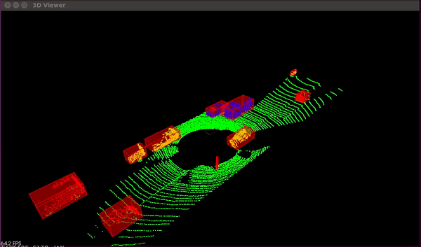
Why Model Fitting
바닥과 같은 곳의 포인트가 관심 영역 포인트보다 많다
바닥과 같은 아웃라이어를 제거하면 컴퓨팅 파워를 줄일 수 있으니 줄여보자
Image Credits: 3D RANSAC Algorithm for Lidar PCD Segmentation https://medium.com/@ajithraj_gangadharan/3d-ransac-algorithm-for-lidar-pcd-segmentation-315d2a51351

Slide 6
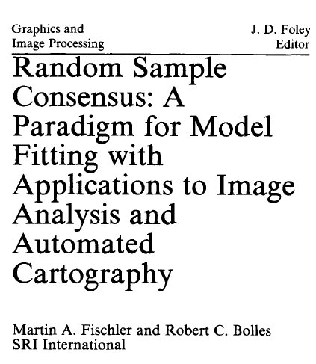
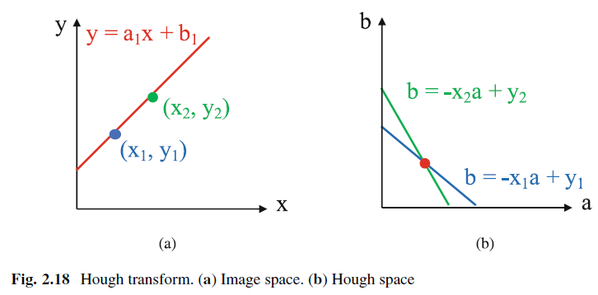
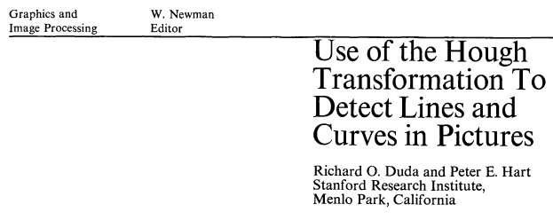
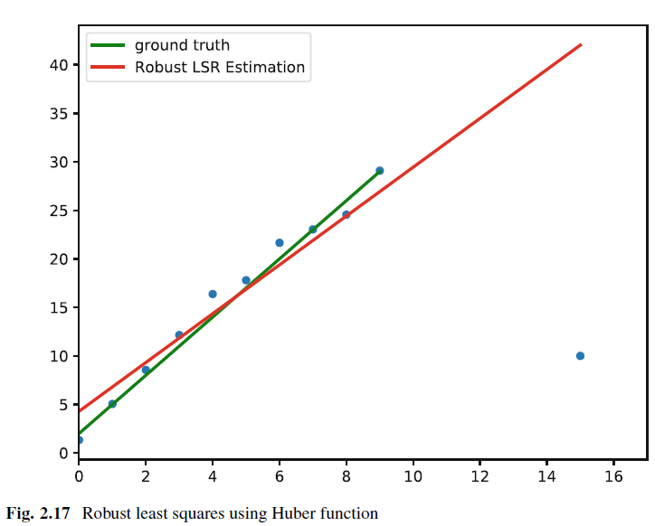
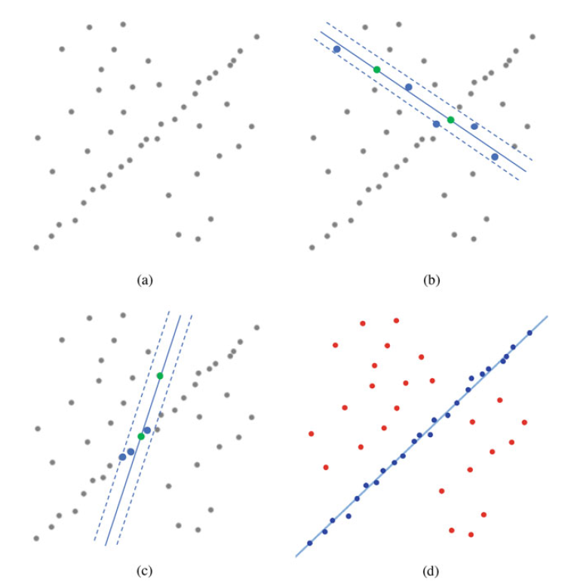
3 Types of model fittings explained in the book
Least squares
Robust least squares
Hough Transform
RANSAC
Inliers가 known이어야 잘 됨!
Outliers에 강건함!
[Ref] Shan Liu, Min Zhang, Pranav Kadam, C.-C. Jay Kuo - 3D Point Cloud Analysis_ Traditional, Deep Learning, and Explainable Machine Learning Methods-Springer (2021)

Slide 7
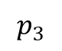
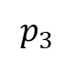
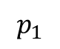
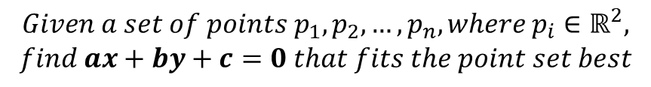
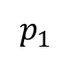
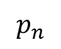
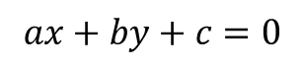
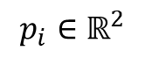
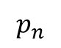
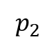
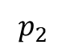
Least Squares
Overdetermined System
Equation number > number of unknowns
Minimize the sum of the squares of the residuals in every equation
$$p_{1}$$
$$p_{3}$$
$$p_{2}$$
$$p_{i}∈ℝ^{2}$$
$$p_{n}$$
$$ax+by+c=0$$
$$p_{1}$$
$$p_{n}$$
$$p_{3}$$
$$p_{2}$$
$$Given a set of points p_{1}, p_{2}, …, p_{n}, where{ p}_{i}∈ℝ^{2},$$
$$find ax+by+c=0 that fits the point set best$$

Slide 8
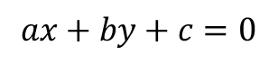
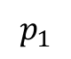
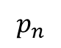
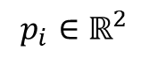
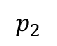
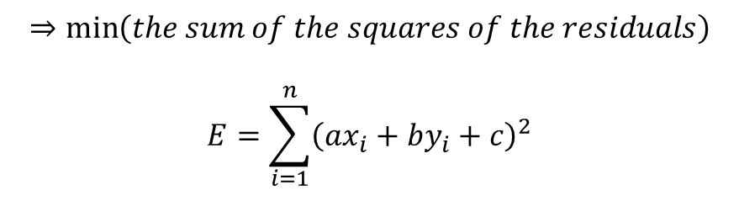
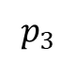
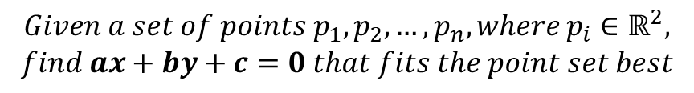
Least Squares
$$p_{i}∈ℝ^{2}$$
$$p_{n}$$
$$ax+by+c=0$$
$$p_{1}$$
$$p_{3}$$
$$p_{2}$$
$$Given a set of points p_{1}, p_{2}, …, p_{n}, where{ p}_{i}∈ℝ^{2},$$
$$find ax+by+c=0 that fits the point set best$$
$$⇒\min\left(the sum of the squares of the residuals\right)$$
$$E=\sum_{i=1}^{n}{{\left(ax_{i}+by_{i}+c\right)}^{2}}$$

Slide 9
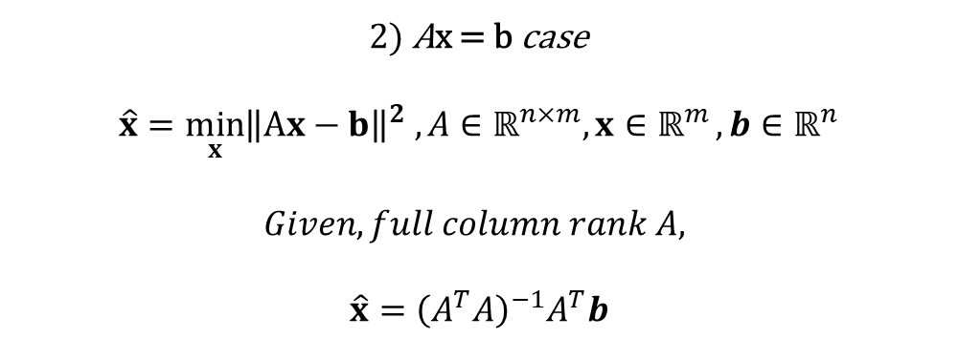
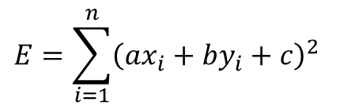

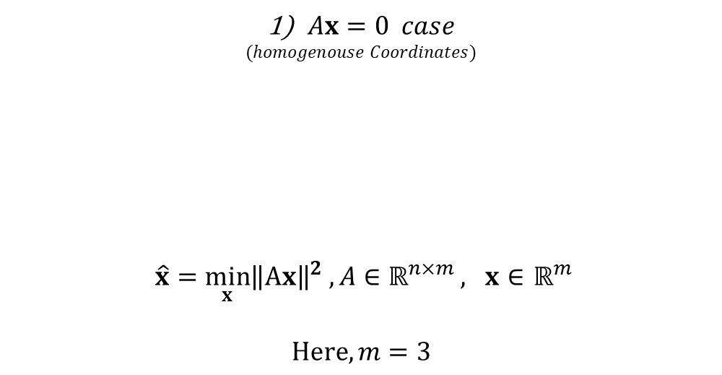
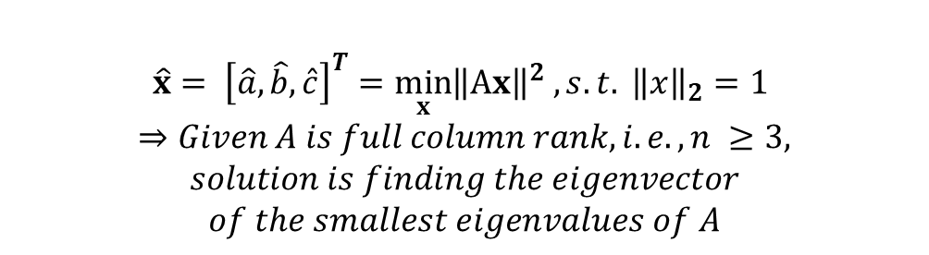
Least Squares
$$E=\sum_{i=1}^{n}{{\left(ax_{i}+by_{i}+c\right)}^{2}}$$
$Ax=0 case$
$$(homogenouse Coordinates)$$
$\hat{x}=\min_{x}{{\left\|Ax\right\|}^{2} , A∈ℝ^{n×m}}, x∈$ $ℝ^{m}$
$$Here, m=3$$
$$A= \left(\begin{matrix}x_{1} & y_{1} & 1 \\ ⋮ & ⋮ & ⋮ \\ x_{n} & y_{n} & 1\end{matrix}\right), x={\left[a,b,c\right]}^{T},$$
2) Ax = b case
$$\hat{x}=\min_{x}{{\left\|Ax−b\right\|}^{2} , A∈ℝ^{n×m}, x∈ℝ^{m}},b∈ℝ^{n}$$
$$Given, full column rank A,$$
$$\hat{x}={\left(A^{T}A\right)}^{−1}A^{T}b$$
$$\hat{x}= {\left[\hat{a},\hat{b},\hat{c}\right]}^{T}=\min_{x}{{\left\|Ax\right\|}^{2} , s.t. {\left\|x\right\|}_{2}=1}$$
$$⇒Given A is full column rank, i.e., n ≥3,$$
$$solution is finding the eigenvector$$
$$of the smallest eigenvalues of A$$

Slide 10
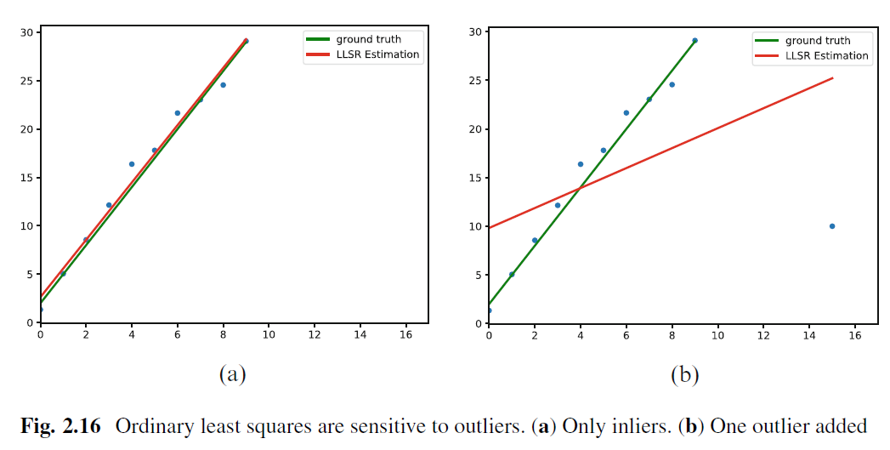
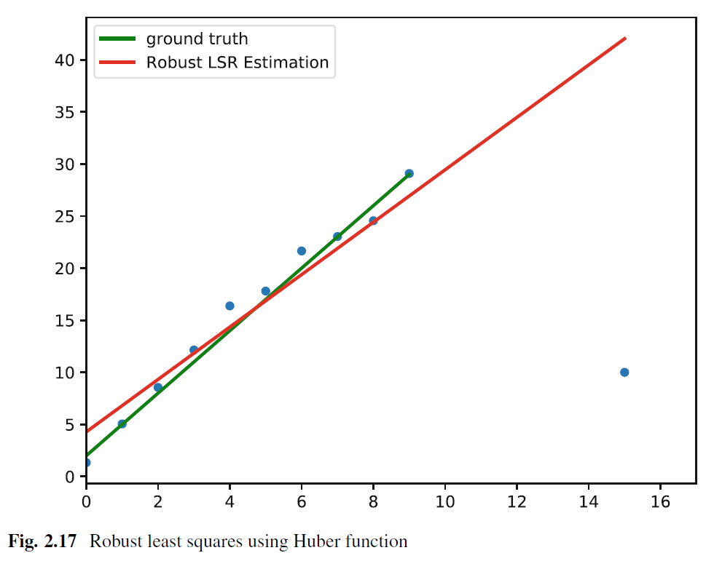
Naïve Least Squares Problems VS Robust ones
Sensitive to outliers
Non-sensitive to outliers

Slide 11
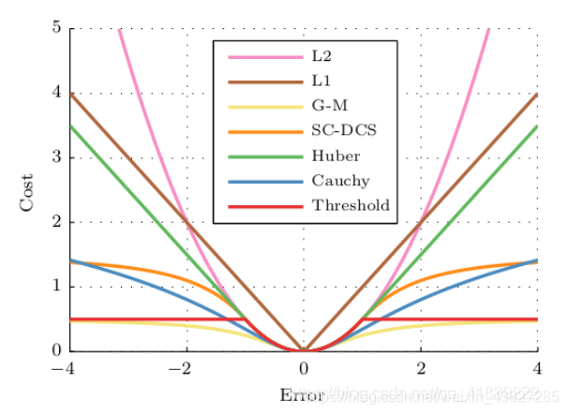
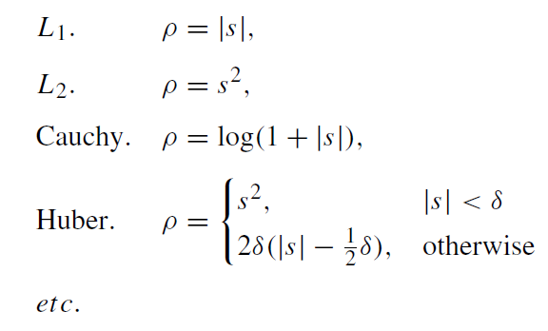
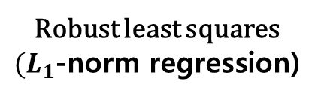

Making robust to outliers for least squares
Ordinary least squares minimization
$(L_{2}$-norm regression)
Robust least squares
$(L_{1}$-norm regression)
assigns a smaller weight to the outliers
Problem: becomes nonlinear
Image credits: https://blog.csdn.net/weixin_43827285/article/details/112058545

Slide 12
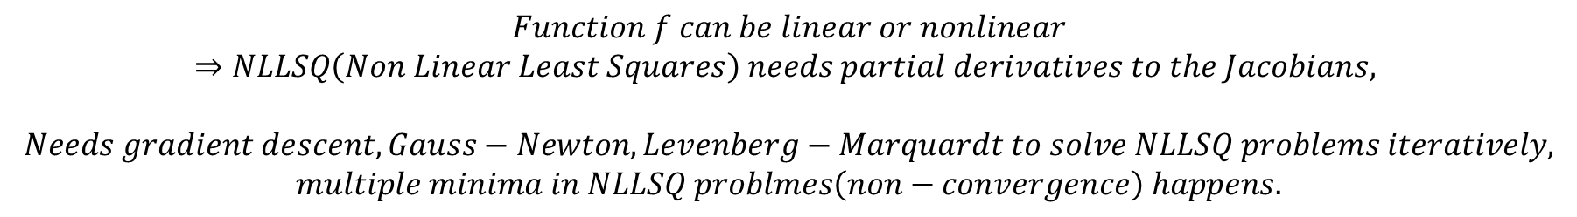
General formulation of LSQ(Least Squres)
$$\hat{x}=\min_{x}{{\left\|f(x)\right\|}^{2} }$$
$$Function f can be linear or nonlinear$$
$$⇒NLLSQ\left(Non Linear Least Squares\right) needs partial derivatives to the Jacobians,$$
$$Needs gradient descent, Gauss−Newton, Levenberg−Marquardt to solve NLLSQ problems iteratively,$$
$$multiple minima in NLLSQ problmes\left(non−convergence\right) happens.$$

Slide 13
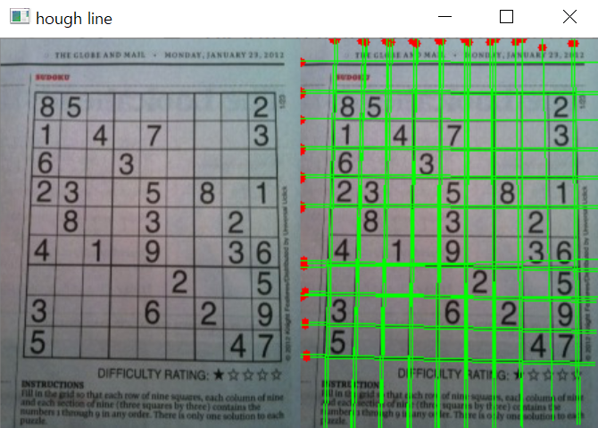
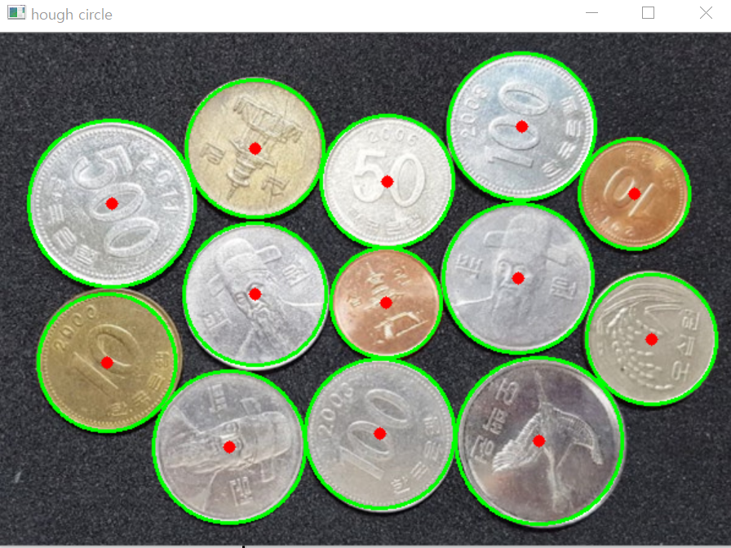
Hough Transform
cv2.HoughLines
cv2.HoughCircles
The Hough transform is a feature extraction technique that can be used to isolate features of a particular shape within an image.
Model fitting
The Hough transform first maps the data from the image space to the parameter space and then uses a voting method to obtain the solution
Image credits: OpenCV - 23. 허프 변환(Hough Transformation) https://bkshin.tistory.com/entry/OpenCV-23-%ED%97%88%ED%94%84-%EB%B3%80%ED%99%98Hough-Transformation

Slide 14
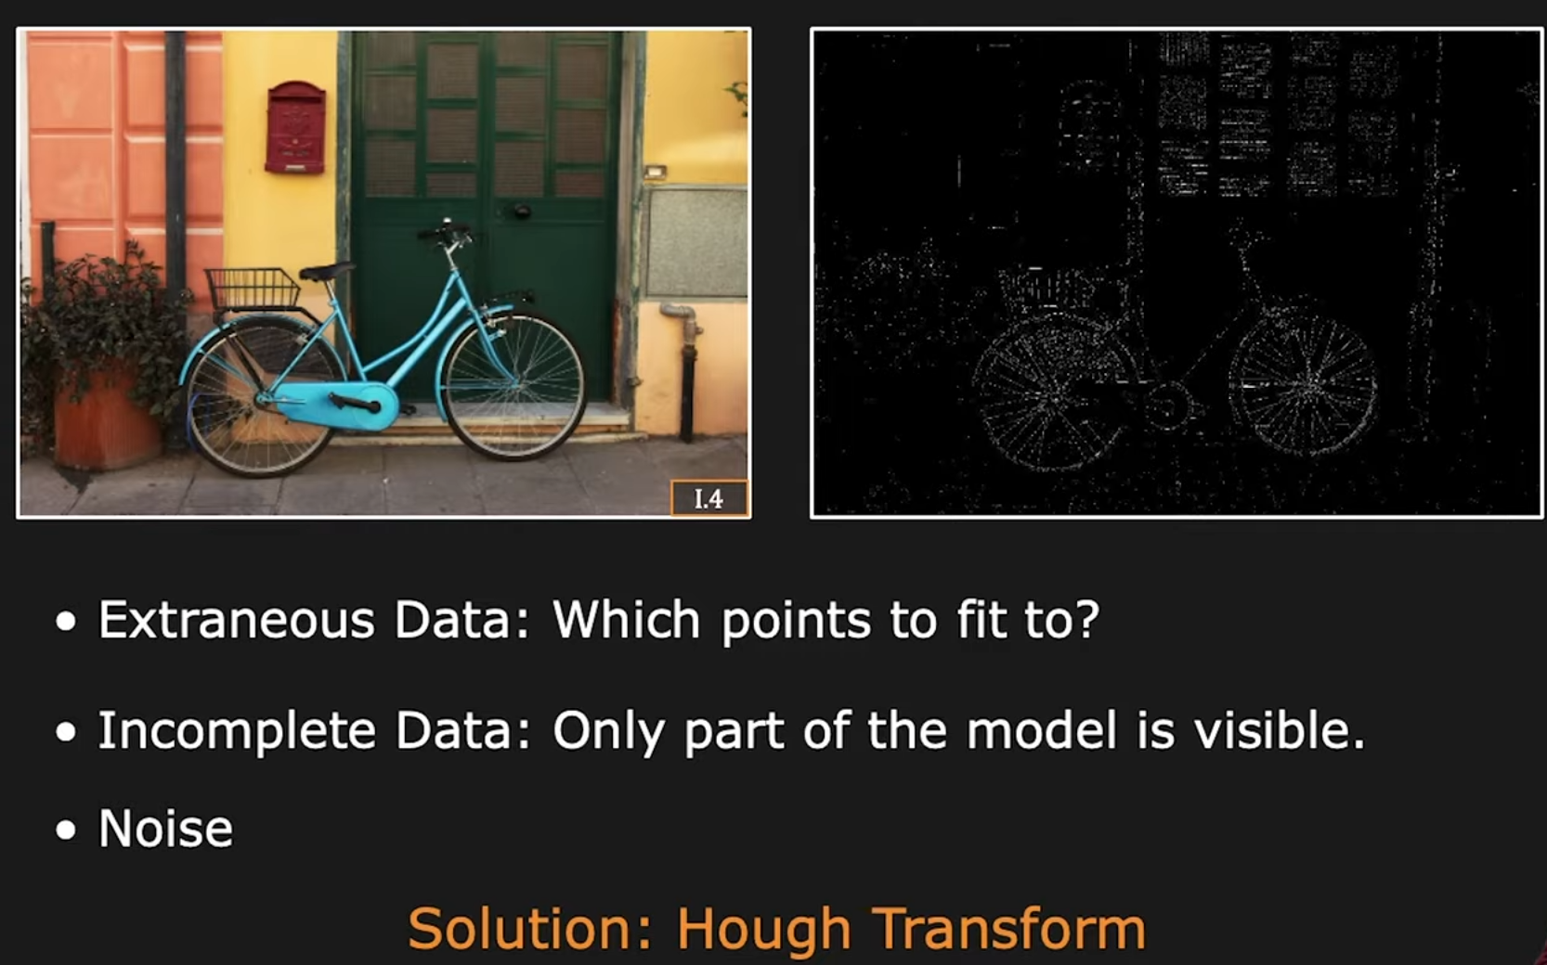
Why Hough Transform
[First Principles of Computer Vision] Hough Transform | Boundary Detection : https://youtu.be/XRBc_xkZREg?si=6eS2GkGg8MdzlZD6

Slide 15
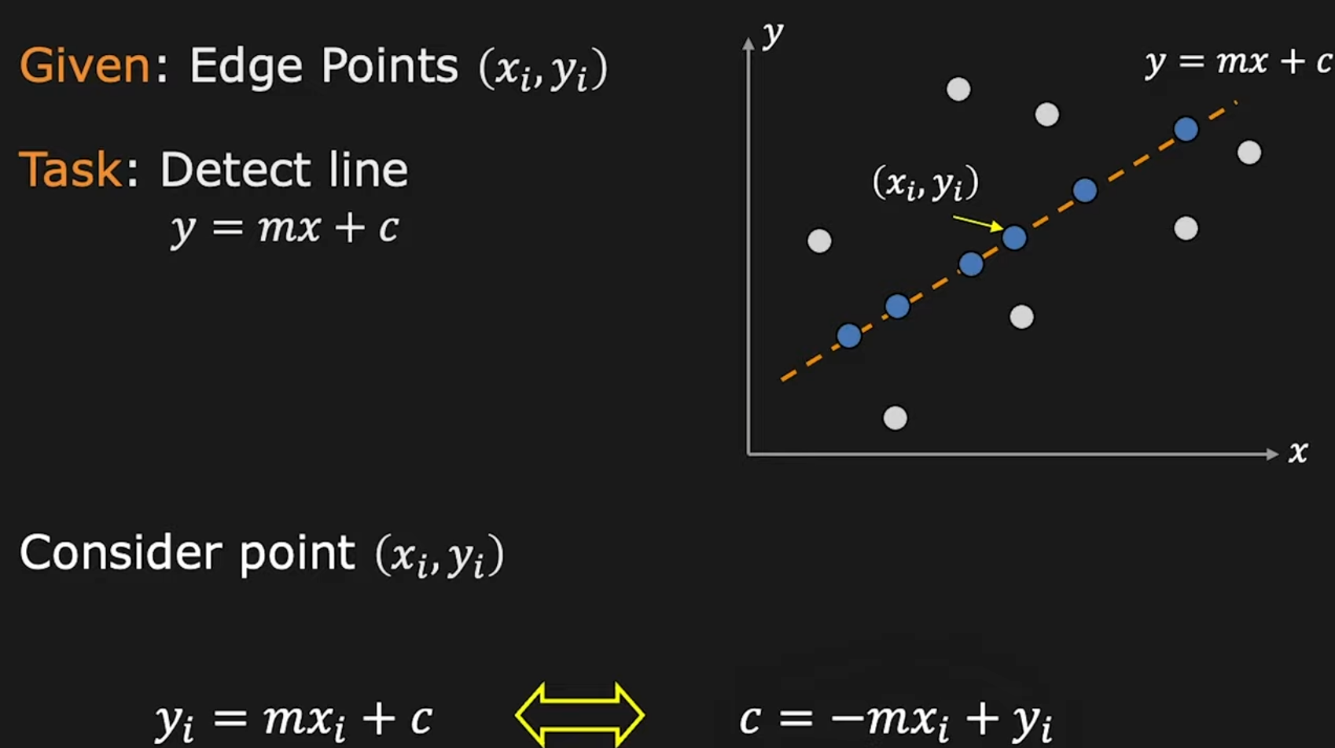
Hough Transform
[First Principles of Computer Vision] Hough Transform | Boundary Detection : https://youtu.be/XRBc_xkZREg?si=6eS2GkGg8MdzlZD6

Slide 16
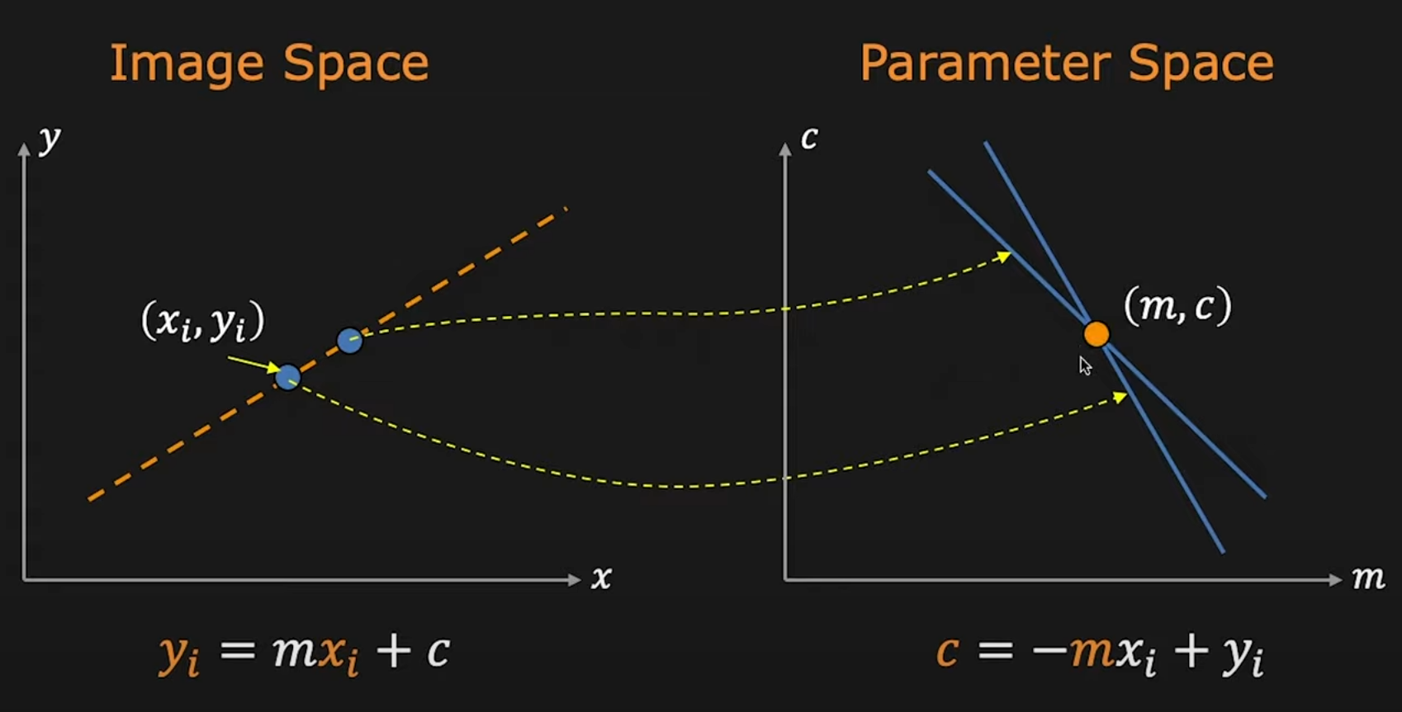
Hough Transform
[First Principles of Computer Vision] Hough Transform | Boundary Detection : https://youtu.be/XRBc_xkZREg?si=6eS2GkGg8MdzlZD6

Slide 17
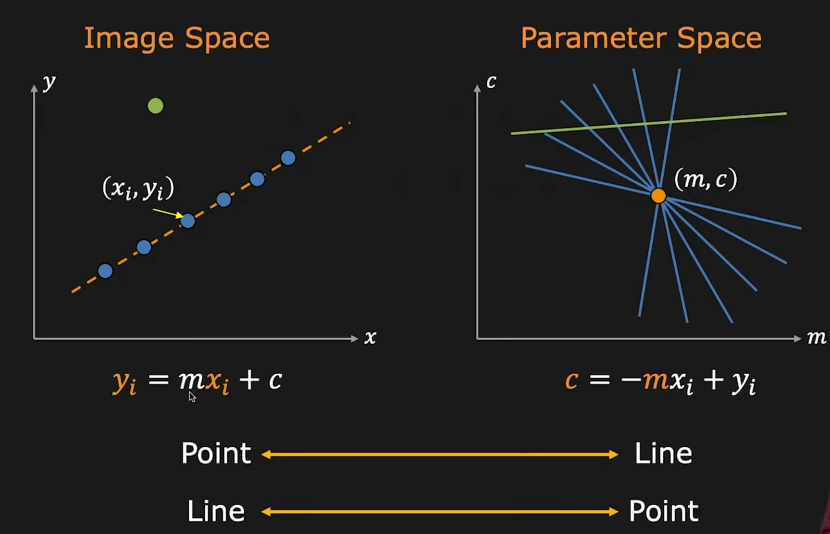
Hough Transform
outlier
[First Principles of Computer Vision] Hough Transform | Boundary Detection : https://youtu.be/XRBc_xkZREg?si=6eS2GkGg8MdzlZD6

Slide 18
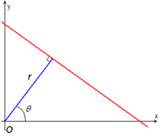
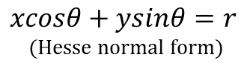
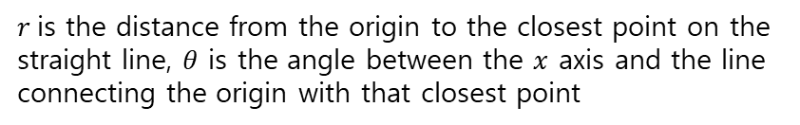

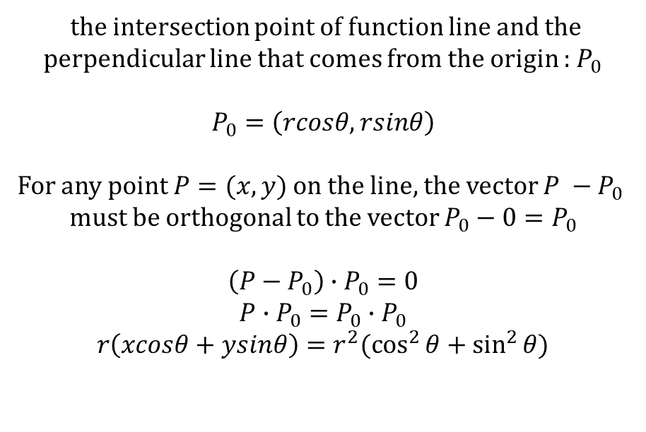
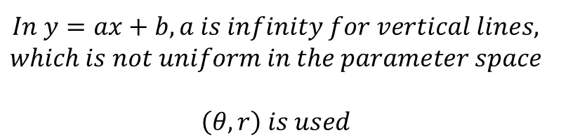
Hough Transform – Needs for changes of expressions
$$which is not uniform in the parameter spaceIn y=ax+b, a is infinity for vertical lines,$$
$$\left(θ, r\right) is used$$
$$y=mx+c$$
the intersection point of function line and the perpendicular line that comes from the origin : $P_{0}$
$$P_{0}=\left(rcosθ, rsinθ\right)$$
For any point $P=(x,y)$ on the line, the vector $P −P_{0}$
must be orthogonal to the vector $P_{0}−0=P_{0}$
$$\left(P−P_{0}\right)∙P_{0}=0$$
$$P∙P_{0}=P_{0}∙P_{0}$$
$$r\left(xcosθ+ysinθ\right)=r^{2}(\cos^{2}{θ+\sin^{2}{θ)}}$$
$$xcosθ+ysinθ=r$$
(Hesse normal form)
$$xcosθ+ysinθ=r (∵\cos^{2}{θ+\sin^{2}{θ=1)}}$$
$r$is the distance from the origin to the closest point on the straight line, $θ$ is the angle between the $x$ axis and the line connecting the origin with that closest point
[First Principles of Computer Vision] Hough Transform | Boundary Detection : https://youtu.be/XRBc_xkZREg?si=6eS2GkGg8MdzlZD6

Slide 19
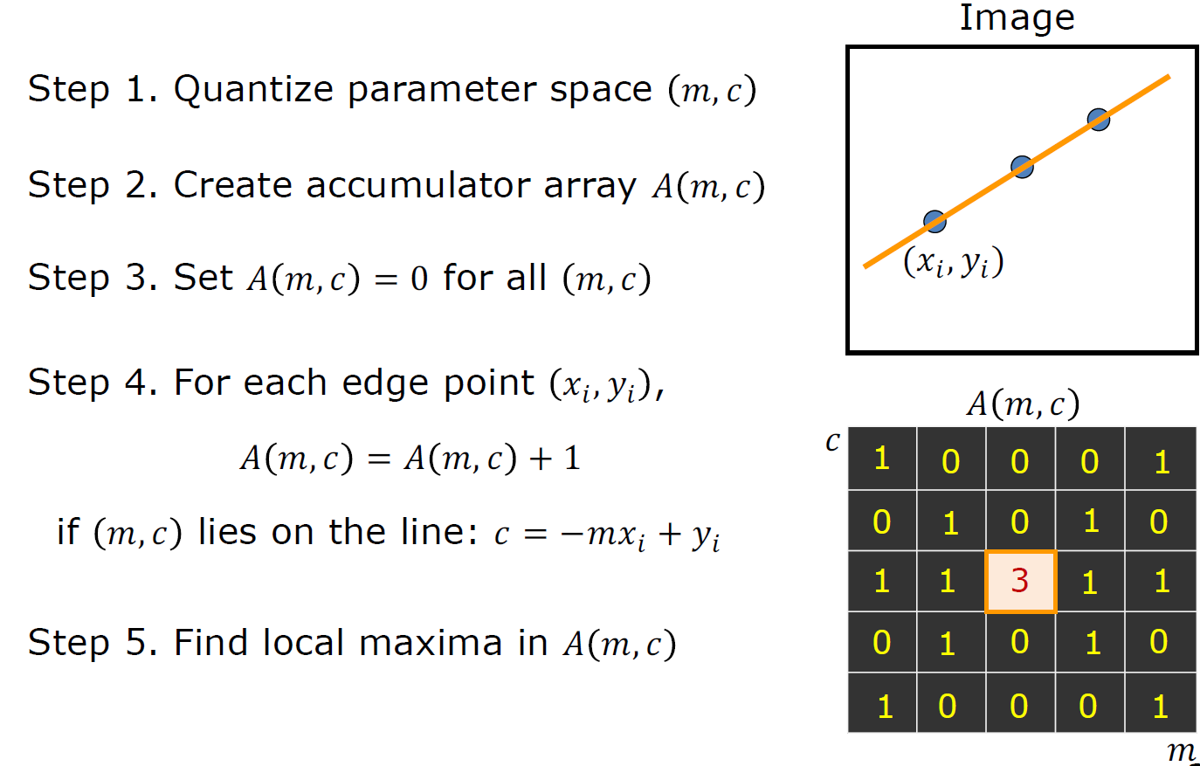
Hough Transform
[First Principles of Computer Vision] Hough Transform | Boundary Detection : https://youtu.be/XRBc_xkZREg?si=6eS2GkGg8MdzlZD6

Slide 20
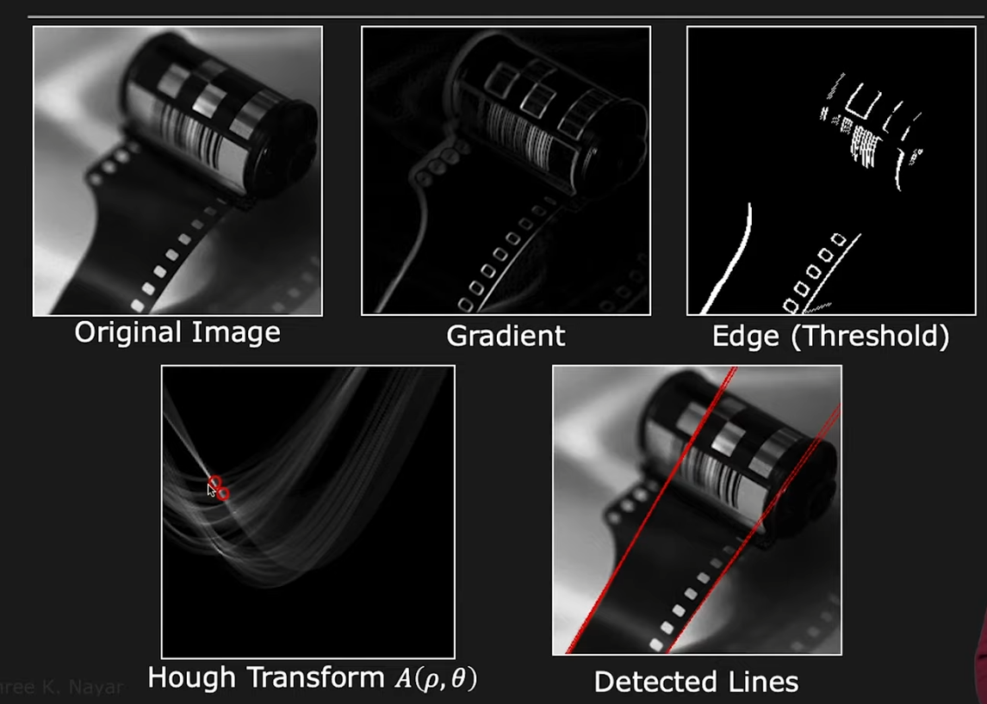
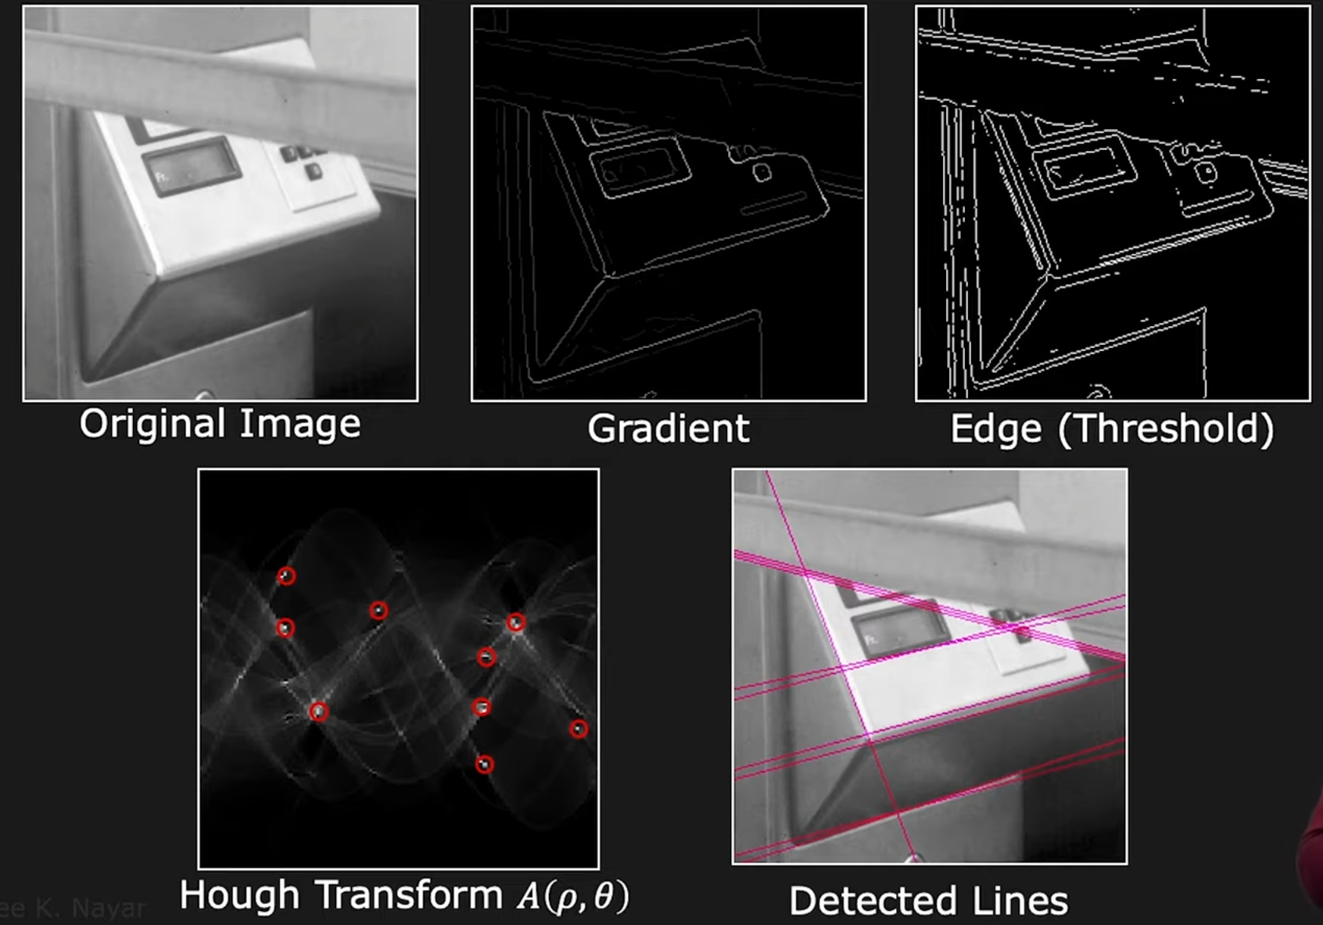
Hough Transform - results
[First Principles of Computer Vision] Hough Transform | Boundary Detection : https://youtu.be/XRBc_xkZREg?si=6eS2GkGg8MdzlZD6

Slide 21


Hough Transform - circles
$$\left(a, b, r\right)unknown$$
[First Principles of Computer Vision] Hough Transform | Boundary Detection : https://youtu.be/XRBc_xkZREg?si=6eS2GkGg8MdzlZD6

Slide 22

Hough Transform
[First Principles of Computer Vision] Hough Transform | Boundary Detection : https://youtu.be/XRBc_xkZREg?si=6eS2GkGg8MdzlZD6

Slide 23

Hough Transform
[First Principles of Computer Vision] Hough Transform | Boundary Detection : https://youtu.be/XRBc_xkZREg?si=6eS2GkGg8MdzlZD6

Slide 24

Hough Transform
[First Principles of Computer Vision] Hough Transform | Boundary Detection : https://youtu.be/XRBc_xkZREg?si=6eS2GkGg8MdzlZD6

Slide 25

Hough Transform
It can be extended to numerous models and usually works well for models with less than 3 unknown parameters. However, it does not scale well with complicated models.
[First Principles of Computer Vision] Hough Transform | Boundary Detection : https://youtu.be/XRBc_xkZREg?si=6eS2GkGg8MdzlZD6

Slide 26

Hough Transform
The University of British Columbia, CPSC 425: Computer Vision Lecture 15: Hough Transform

Slide 27

RANSAC(Random Sample Consensus)
RANSAC(Random Sample Consensus)
어떻게?
무엇을?
어떻게?
무작위로 뽑을건데
포인트들 중 일부 샘플만
그 샘플들로 만들어진 모델에
데이터들이 어떻게 합의되는지 볼게
(outliers, inliers)

Slide 28

RANSAC(Random Sample Consensus)
The University of British Columbia, CPSC 425: Computer Vision Lecture 14: Planar Geometry and RANSAC

Slide 29



RANSAC(Random Sample Consensus)
$$y_{i}=mx_{i}+c$$
$$unknown m, c)$$
3D Computer Vision | Lecture 4 (Part 2): Robust homography estimation : https://youtu.be/v3322cNhCTk?si=eDKK-kCbMxvOJoYk

Slide 30


RANSAC(Random Sample Consensus)
3D Computer Vision | Lecture 4 (Part 2): Robust homography estimation : https://youtu.be/v3322cNhCTk?si=eDKK-kCbMxvOJoYk

Slide 31


RANSAC(Random Sample Consensus)
3D Computer Vision | Lecture 4 (Part 2): Robust homography estimation : https://youtu.be/v3322cNhCTk?si=eDKK-kCbMxvOJoYk

Slide 32

RANSAC(Random Sample Consensus)
3D Computer Vision | Lecture 4 (Part 2): Robust homography estimation : https://youtu.be/v3322cNhCTk?si=eDKK-kCbMxvOJoYk

Slide 33

RANSAC(Random Sample Consensus)
3D Computer Vision | Lecture 4 (Part 2): Robust homography estimation : https://youtu.be/v3322cNhCTk?si=eDKK-kCbMxvOJoYk

Slide 34


RANSAC(Random Sample Consensus)
$$w=1−e,$$
$$where e is the probability$$
$$that a point is an outlier$$
3D Computer Vision | Lecture 4 (Part 2): Robust homography estimation : https://youtu.be/v3322cNhCTk?si=eDKK-kCbMxvOJoYk

Slide 35


RANSAC(Random Sample Consensus)
$$\left(N for p=0.99 for a given s and e\right)$$
$$as the proportion of outliers and minimum number of points$$
$$needed to solve the model increase, the number of iterations needed also increases$$

Slide 36
RANSAC(Random Sample Consensus)
Pros
Cons
Robustly deal with outliers
Simple to use
Small inlier ratio would be enough
Non-Determistics (No same results)
Initialization Sensitivity
Parameter Selection
Computationally Intensive (minor?)
If outliers have some structure, outcome would be bad
Not possible to be used in end-to-end deep learning
(not error metric based)
No Prior knowledge is used, only randoms!
PROSAC (Ordered search with increasing pool)
Lo-RANSAC (Inner RANSAC with iterative optimization)

Slide 37
Contents & Objectives
Model Fitting
Least Squares Fitting
Hough Transform
RANSAC (Random Sample Consensus)
Point Cloud Features
Feature Detectors
Harris 3D/6D
Intrinsic Shape Signatures
Feature Descriptors
Point Feature Histogram
Fast Point Feature Histogram
Signature of Histograms of Orientations
What is Least Squares Limitations and why?
How Hough Transform & RANSAC solves the limits
What is 2D Harris Corner Detector and 3D Harris Corner Detector?
Differences between PFH, FPFH, LRF, SHOT
(Basics)
Taylor Expansions
Eigen Values and decompositions
[Ref] Shan Liu, Min Zhang, Pranav Kadam, C.-C. Jay Kuo - 3D Point Cloud Analysis_ Traditional, Deep Learning, and Explainable Machine Learning Methods-Springer (2021)

Slide 38

Point Cloud Features – Harris Corner Detector
The University of British Columbia, CPSC 425: Computer Vision Lecture 9: Corner Detection

Slide 39

Point Cloud Features – Harris Corner Detector
For images, corners are the points at which edges meet, and edges are a sudden change in image brightness.
Corners are more distinctive than flat regions or edges.
First, corners have large variations in neighborhood.
(all directions)
Second, corners are invariant to translation, rotation, and illuminations
Image credits: [시각지능] Detecting corners: https://velog.io/@claude_ssim/%EC%8B%9C%EA%B0%81%EC%A7%80%EB%8A%A5-Detecting-corners-1

Slide 40


Point Cloud Features – Harris Corner Detector
Image credits: [시각지능] Detecting corners: https://velog.io/@claude_ssim/%EC%8B%9C%EA%B0%81%EC%A7%80%EB%8A%A5-Detecting-corners-1

Slide 41



$$E\left(u, v\right)=\sum_{x, y∈Ω}{w\left(x,y\right){\left[I\left(x+u, y+v\right) −I\left(x,y\right)\right]}^{2}}$$
Point Cloud Features – Harris Corner Detector
$$Given an image I , if a patch x, y is shifted by \left[u, v\right]$$
$$and w\left(x,y\right)is the window function(to give weights on the center),$$
$$then the intensity change$$
$$(binary or Gaussian)$$
Image credits: [시각지능] Detecting corners: https://velog.io/@claude_ssim/%EC%8B%9C%EA%B0%81%EC%A7%80%EB%8A%A5-Detecting-corners-1

Slide 42




$$x= \left({x \atop y}\right), Δ=\left({u \atop v}\right)$$
Point Cloud Features – Harris Corner Detector
$$if w\left(x,y\right)=1,$$
$$E\left(u, v\right)=\sum_{x, y∈Ω}{w\left(x,y\right){\left[I\left(x+u, y+v\right) −I\left(x,y\right)\right]}^{2}}$$
M
Cf, Taylor expansion: only works well on near point a
Harris Corner Detection : https://velog.io/@kowoonho/Harris-Corner-Detection

Slide 43


Point Cloud Features – Harris Corner Detector
How do we find most sensitive points
$$x axis: u, y axis: v, z axis:Error function$$
Image credits: [시각지능] Detecting corners: https://velog.io/@claude_ssim/%EC%8B%9C%EA%B0%81%EC%A7%80%EB%8A%A5-Detecting-corners-1

Slide 44


Point Cloud Features – Harris Corner Detector
Compute eigenvalues and eigenvectors
Image credits: [시각지능] Detecting corners: https://velog.io/@claude_ssim/%EC%8B%9C%EA%B0%81%EC%A7%80%EB%8A%A5-Detecting-corners-1

Slide 45



Point Cloud Features – Harris Corner Detector
paraboloid 관점에서 x가 커짐에 따라서 error 값이 커지는 속도가 2배만큼 빨라진 것
paraboloid 관점에서 y가 커짐에 따라서 error 값이 커지는 속도가 2배만큼 빨라진 것
Image credits: [시각지능] Detecting corners: https://velog.io/@claude_ssim/%EC%8B%9C%EA%B0%81%EC%A7%80%EB%8A%A5-Detecting-corners-1

Slide 46

Point Cloud Features – Harris Corner Detector
Image credits: [시각지능] Detecting corners: https://velog.io/@claude_ssim/%EC%8B%9C%EA%B0%81%EC%A7%80%EB%8A%A5-Detecting-corners-1

Slide 47

Point Cloud Features – Harris Corner Detector
Eigenvalues: scaling
Image credits: [시각지능] Detecting corners: https://velog.io/@claude_ssim/%EC%8B%9C%EA%B0%81%EC%A7%80%EB%8A%A5-Detecting-corners-1

Slide 48

Point Cloud Features – Harris Corner Detector
Image credits: [시각지능] Detecting corners: https://velog.io/@claude_ssim/%EC%8B%9C%EA%B0%81%EC%A7%80%EB%8A%A5-Detecting-corners-1

Slide 49

Point Cloud Features – Harris Corner Detector
Image credits: [시각지능] Detecting corners: https://velog.io/@claude_ssim/%EC%8B%9C%EA%B0%81%EC%A7%80%EB%8A%A5-Detecting-corners-1

Slide 50


Point Cloud Features – Harris Corner Detector
일반적으로 M이 symmetric하면 위와 같이 분리가 된다.
R 자체가 orthonormal matrix이기 때문에 transpose와 inverse가 동일하게 된다.
Image credits: [시각지능] Detecting corners: https://velog.io/@claude_ssim/%EC%8B%9C%EA%B0%81%EC%A7%80%EB%8A%A5-Detecting-corners-1

Slide 51

Point Cloud Features – Harris Corner Detector
Interpreting Eigenvalues
Image credits: [시각지능] Detecting corners: https://velog.io/@claude_ssim/%EC%8B%9C%EA%B0%81%EC%A7%80%EB%8A%A5-Detecting-corners-1

Slide 52

Point Cloud Features – Harris Corner Detector
Image credits: [시각지능] Detecting corners: https://velog.io/@claude_ssim/%EC%8B%9C%EA%B0%81%EC%A7%80%EB%8A%A5-Detecting-corners-1

Slide 53


Point Cloud Features – Harris Corner Detector
Image credits: [시각지능] Detecting corners: https://velog.io/@claude_ssim/%EC%8B%9C%EA%B0%81%EC%A7%80%EB%8A%A5-Detecting-corners-1

Slide 54





Point Cloud Features – Harris Corner Detector
Image credits: [시각지능] Detecting corners: https://velog.io/@claude_ssim/%EC%8B%9C%EA%B0%81%EC%A7%80%EB%8A%A5-Detecting-corners-1

Slide 55


Point Cloud Features – Harris Corner Detector
NOT Invariant to Scale Changes
The University of British Columbia, CPSC 425: Computer Vision Lecture 9: Corner Detection

Slide 56



Point Cloud Features – Harris Corner Detector 3D
Cf. 2D $E\left(u, v\right)=\sum_{x, y∈Ω}{w\left(x,y\right){\left[I\left(x+u, y+v\right) −I\left(x,y\right)\right]}^{2}}$

Slide 57

Point Cloud Features – Harris Corner Detector 3D

Slide 58



Point Cloud Features – Harris Corner Detector 3D
$$→$$

Slide 59

Point Cloud Features – Harris Corner Detector 3D

Slide 60


Point Cloud Features – Harris Corner Detector 3D
Harris 6D
- uses a combination of intensity and surface normal
- M is the covariance matrix of $[I_{x}, I_{y}, I_{z}, n_{x}, n_{y}, n_{z}]$,
the Tomasi response R is λ4.
- R = λ3, Harris 6D is a superset of Harris 3D without intensity which is too loose.
- R = λ5, it requires the corner to be both a geometric corner and an intensity corner, which is too strict

Slide 61





Point Cloud Features – Intrinsic Shape Signatures
ISS
- originally a shape descriptor for 3D object recognition
2009, Yu Zhong, Intrinsic Shape Signatures: A Shape Descriptor for 3D Object Recognition
the points in sparsely sampled regions will contribute more than those in densely sampled regions

Slide 62
Feature Descriptors
It must be robust to transformations: rigid transformations (the ones that do not change the distance between points) like translations and rotations must not affect the feature. Even if we play with the cloud a bit beforehand, there should be no difference.
It must be robust to noise: measurement errors that cause noise should not change the feature estimation much.
It must be resolution invariant: if sampled with different density (like after performing downsampling), the result must be identical or similar.
Descriptors are needed!!
PCL/OpenNI tutorial 4: 3D object recognition (descriptors)

Slide 63

Feature Descriptors
Global
Local
PCL/OpenNI tutorial 4: 3D object recognition (descriptors)

Slide 64
Feature Descriptors
Histogram-based
Signature-based
Encode local geometric variations
into a histogram
- Point Feature Histogram (PFH)
- Fast Point Feature Histogram (FPFH)
Compute point distributions
based on a local reference frame
- Local Reference Frame (LRF)
- Signature of histogram of orientations (SHOT)

Slide 65


Feature Descriptors - Point Feature Histogram
Select neighbor points within sphere of radius r (K-neighborhood)
For every pairs of points p1 and p2 and their estimated (PCA) normal n1, n2 -> Define Darboux uvn frame

Slide 66









Feature Descriptors - Point Feature Histogram
$$α=v⋅n_{t}$$
$$d=|\left|p_{t}−p_{s}\right||$$
$$Φ=u⋅\frac{{(P}_{t}−Ps)}{d} \\ θ=atan(w{⋅n}_{t}, u⋅n_{t})$$
$$α, d, ϕ, θ=f_{1},f_{2},f_{3},f_{4}$$
c.f. In order to make viewpoint independent, d is usually ignored.

Slide 67




Feature Descriptors - Point Feature Histogram
- $1 feature \left(f_{2} \right) for Euclidean Distance$
- $3 feature \left(f_{1} f_{3}, f_{4}\right) for angular variations$
- 1 threshold for each feature: $f_{i}<s_{i} →0, otherwise 1$
- Due to the calculation issues, $2^{4}=16 bins\left(idx\right)$
($f_{1}만$ threshold보다 크면, 0001 등)

Slide 68


Feature Descriptors - Fast Point Feature Histogram
- All point pairs in the k-neighborhood should be computed:
- Time complexity of FPH:$O\left(nk^{2}\right)∵c\left(time of computing sinple pair\right)×\frac{k(k−1)}{2} ×n\left(\# of points\right) for a single point!$
- Time complexity of FPFH: $O\left(nk\right) :c ×k×n$
FPFH
(Partially connected)
FPH
(Fully connected)

Slide 69



for each point we re-determine its k neighbors and use the
neighboring SPFH values to weight the final histogram of p
(called FPFH):
Feature Descriptors - Fast Point Feature Histogram
Step 1) SPFH(Simplified Point Feature Histogram)
Step 2)
For each query point p,
we compute only the relationships
Between itself and its neighbors
$w_{k}= |\left|p_{t}−p_{s}\right||$ (distance between pt and neighbor point ps)

Slide 70


Feature Descriptors - Fast Point Feature Histogram
Details
Reordering the points helps!
Distance is dropped

Slide 71

Feature Descriptors - Fast Point Feature Histogram
Signature of Histograms of Orientations

Slide 72
References
Least Squares:
Least Squares - An Informal Introduction (Cyrill Stachniss)
SLAM Online Study | SLAM DUNK Season 2 | An Informal Introduction to Least Squares
발표자(Peter Woo) 고화질 영상
Hough Transform:
[First Principle of Computer Vision] Hough Transform | Boundary Detection
The University of British Columbia, CPSC 425: Computer Vision Lecture 15: Hough Transform
RANSAC:
3D Computer Vision | Lecture 4 (Part 2): Robust homography estimation
SLAM Online Study | SLAM DUNK Season 2 | RANSAC
The University of British Columbia, CPSC 425: Computer Vision Lecture 14: Planar Geometry and RANSAC
Harris Corner Detector:
[시각지능] Detecting corners (POSTECH의 오태현 교수님의 시각지능 강의)
The University of British Columbia, CPSC 425: Computer Vision Lecture 9: Corner Detection
ISS(Intrinsic Shape Signatures)
Intrinsic Shape Signatures: A Shape Descriptor for 3D Object Recognition (Original Paper)

Slide 73
References
Point Descriptors:
Overall:
PCL/OpenNI tutorial 4: 3D object recognition (descriptors)
PFH:
원 논문: Persistent Point Feature Histograms for 3D Point Clouds
한국인 블로그: PFH
PFH & FPFH:
[AIRLAB@KHU 논문세미나] Fast Point Feature Histograms(FPFH) for 3D Registration
FPFH:
원 논문: Unique Signatures of Histograms for Local Surface Description

Slide 74
3D Sensor Data Processing (2023)
Thank You
🗂️3D Sensor Data Processing Curriculum

Slide 75

Least Squares
$Ax=0 case$
$Ax=b case$

Slide 76
GN(Gauss-Newton), LM(Levenberg-Marquardt)

